Slide 1
Excess COVID-19 Deaths Modeling
Davit Sargsyan Last Updated: 1/31/2025

Slide 2
Data processing and subsetting
Data: Excess Death Month_cause_State_ ETS Forecast_2023_11_AddUS_TO_SEND.csv
Long description | Label
COVID-19 (U07.1) | COVID-19
Influenza and pneumonia (J09-J18) | Influenza and pneumonia
Chronic lower respiratory diseases (J40-J47) | Lungs
Cerebrovascular diseases (I60-I69) | CVD
Diseases of heart (I00-I09,I11,I13,I20-I51) | Heart
Essential hypertension and hypertensive renal disease (I10,I12,I15) | Hypertension
Malignant neoplasms (C00-C97) | Cancer
Diabetes mellitus (E10-E14) | Diabetes
Chronic liver disease and cirrhosis (K70,K73-K74) | Liver
Alzheimer disease (G30) | Alzheimer
Parkinson disease (G20-G21) | Parkinson
Septicemia (A40-A41) | Septicemia
Intentional self-harm (suicide) (U03,X60-X84,Y87.0) | Suicide
Accidents (unintentional injuries) (V01-X59,Y85-Y86) | Accidents
Not top 15 | Other
DeathDaily = Death/DaysMonth (i.e., average daily death = average monthly death/number of days in that month)
Rate = 10^5*DeathDaily/Population
Divided data into:
Training1: 1/2015 to 2/2019
Testing 1: 3/2019 to 2/2020
COVID-19: 3/1/2020 to 5/2022
Post-COVID: 6/2022 to 9/2023

Slide 3
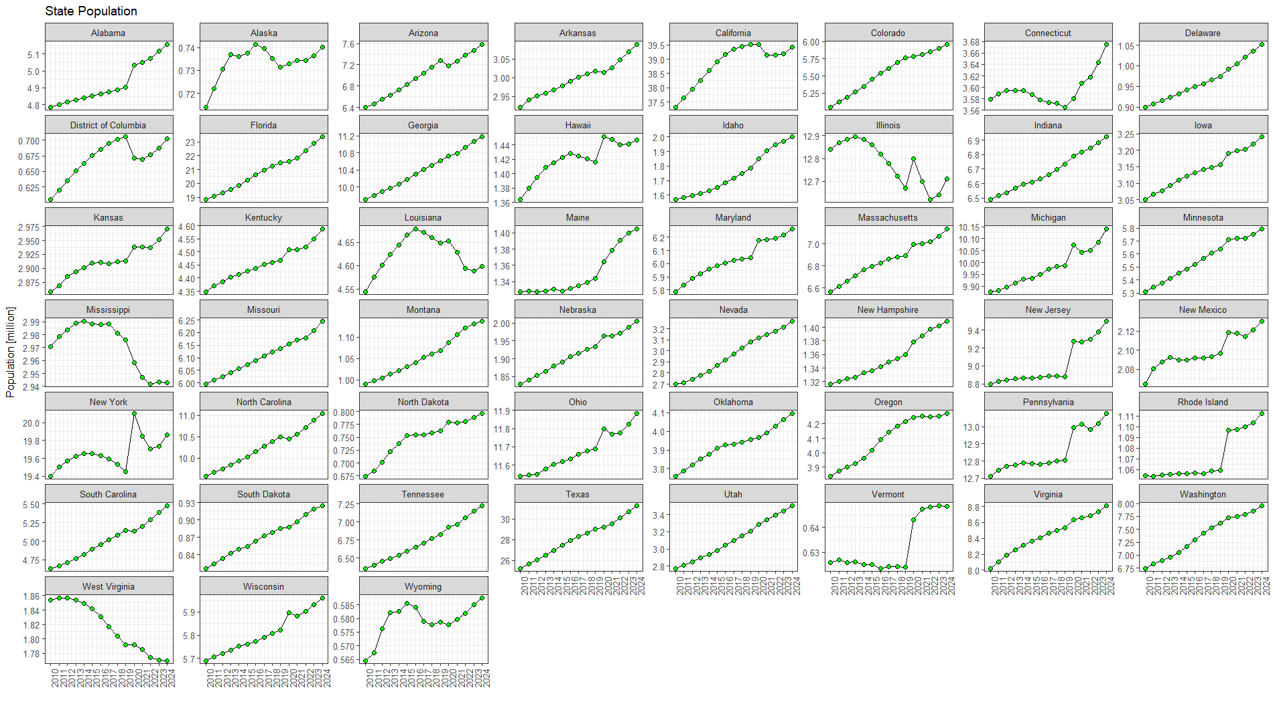
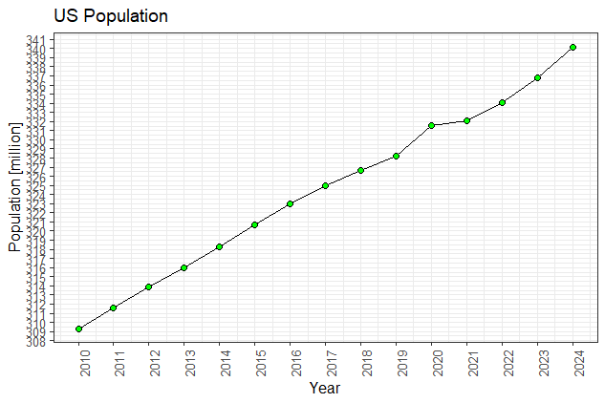
US Population
Note: 2023 populations were not available, so 2022 populations were copied as 2023. Can we update this?

Slide 4
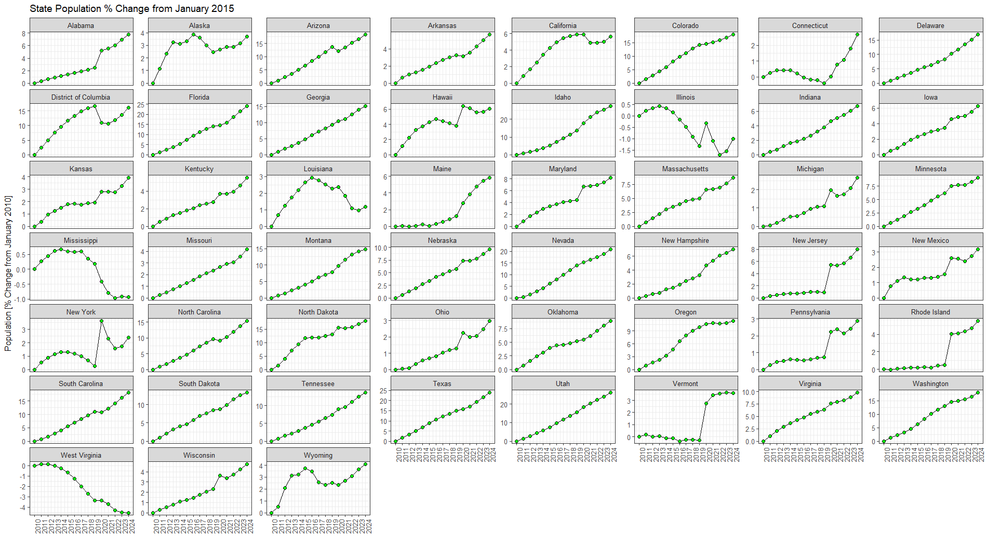
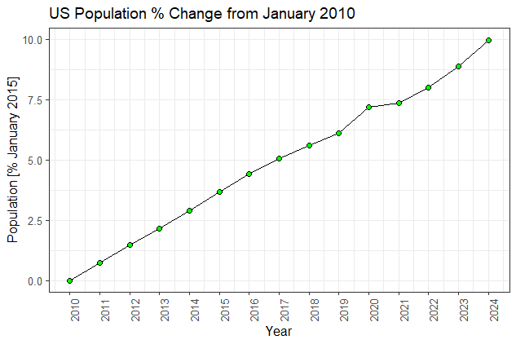
% Population Change from January 2010

Slide 5
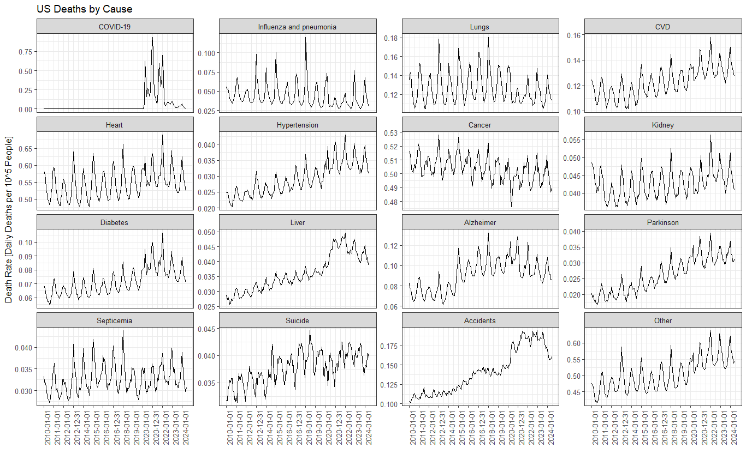
US Deaths by Cause and State
Click on the icon below to open the PDF

Slide 6
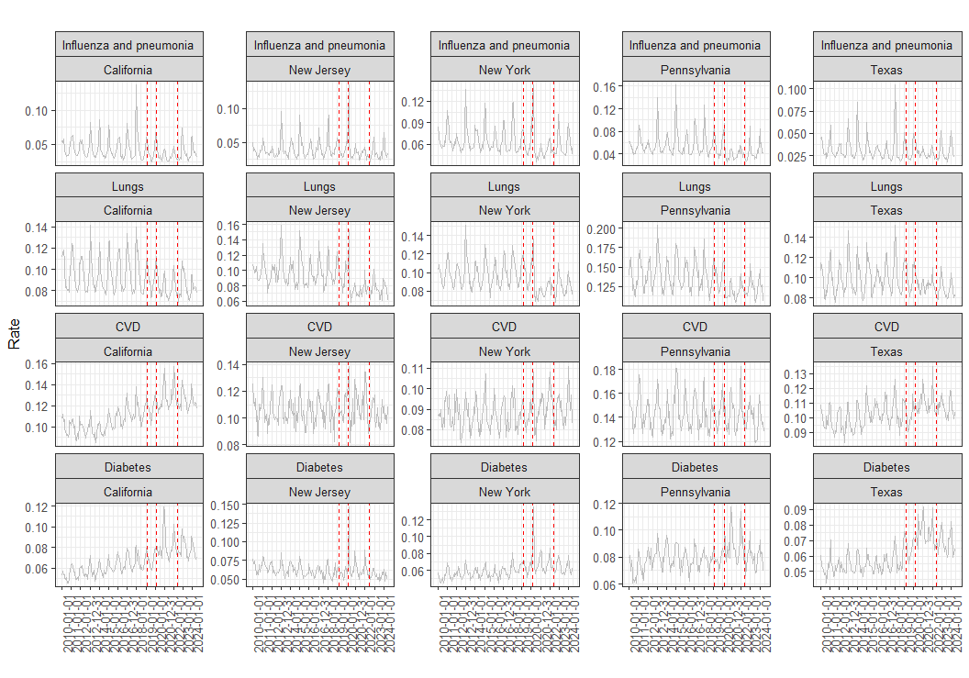
5 States 4 Causes of Death

Slide 7
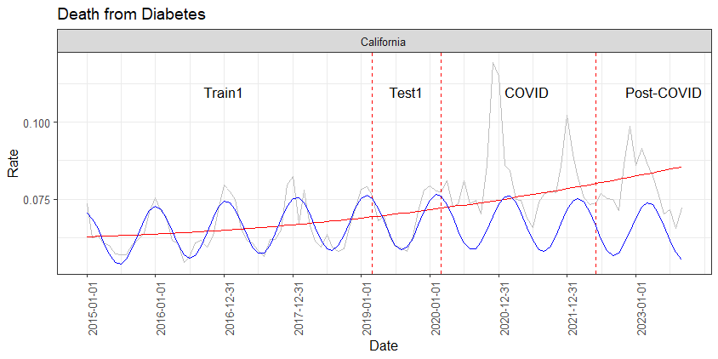
Example: Sinusoidal Model for Death from Diabetes in California
Grey: observations
Red: linear model with a quadratic term (lm):
Rate ~ dt + dt_sqr
Blue: nonlinear least square model (nls::nls)
Rate ~ b0 + b1*dt + b2*dt_sqr + b3*sin(b4 + b5*dt)
Mean Absopute Percent Error (MAPE):
MAPE = 100*mean(abs(Observed_Rate – Predicted_Rate)/(Observed_Rate )
Parameter | Interpretation | Estimate | Std. Error
b0 | Y-intercept | -0.549162862 | 0.965873886
b1 | Linear slope | 0.000067631 | 0.000112475
b2 | Square term, i.e. non-linearity of the trend | -0.000000002 | 0.000000003
b3 | Wave magnitude | -0.008976364 | 0.000730201
b4 | Sin shift to the left | -0.156743146 | 3.624588264
b5 | Wavelength (> 1 shortens, < 1 elongates). Starting value was 1/60 = 0.016(6) | 0.016745471 | 0.000210939

Slide 8
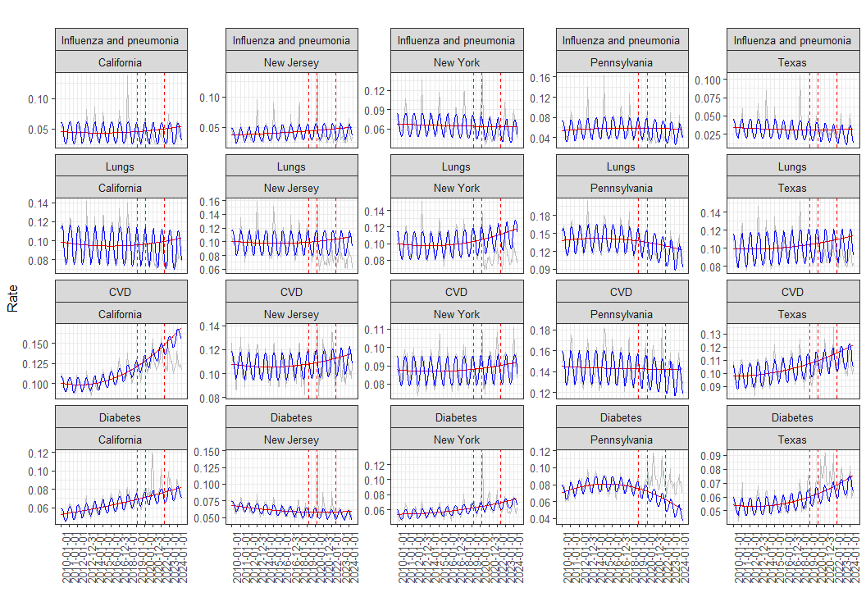
Non-linear Least Squares (aka Sinusoidal Model)
Errors (predicted vs. observed) on the Test1 data (3/1/2019 to 2/1/2020)
State | Cause | MSE | MAE | MedAE
California | Influenza and pneumonia | 5.01E-05 | 5.77E-03 | 6.46E-03
New Jersey | Influenza and pneumonia | 3.16E-05 | 4.61E-03 | 4.25E-03
New York | Influenza and pneumonia | 2.84E-05 | 4.22E-03 | 3.46E-03
Pennsylvania | Influenza and pneumonia | 5.89E-05 | 5.82E-03 | 4.81E-03
Texas | Influenza and pneumonia | 1.54E-05 | 3.10E-03 | 2.49E-03
California | Lungs | 2.58E-05 | 4.40E-03 | 4.79E-03
New Jersey | Lungs | 1.05E-04 | 9.14E-03 | 8.81E-03
New York | Lungs | 2.82E-05 | 4.20E-03 | 3.57E-03
Pennsylvania | Lungs | 6.42E-05 | 6.58E-03 | 6.34E-03
Texas | Lungs | 1.78E-05 | 3.51E-03 | 3.04E-03
California | CVD | 5.87E-05 | 6.50E-03 | 5.49E-03
New Jersey | CVD | 3.53E-05 | 5.01E-03 | 4.87E-03
New York | CVD | 1.75E-05 | 3.63E-03 | 3.56E-03
Pennsylvania | CVD | 6.46E-05 | 6.77E-03 | 6.02E-03
Texas | CVD | 3.64E-05 | 5.34E-03 | 5.02E-03
California | Diabetes | 9.17E-06 | 2.60E-03 | 2.52E-03
New Jersey | Diabetes | 3.09E-05 | 4.97E-03 | 5.13E-03
New York | Diabetes | 2.29E-05 | 4.07E-03 | 4.53E-03
Pennsylvania | Diabetes | 4.53E-05 | 5.65E-03 | 4.78E-03
Texas | Diabetes | 2.38E-05 | 4.53E-03 | 4.35E-03

Slide 9
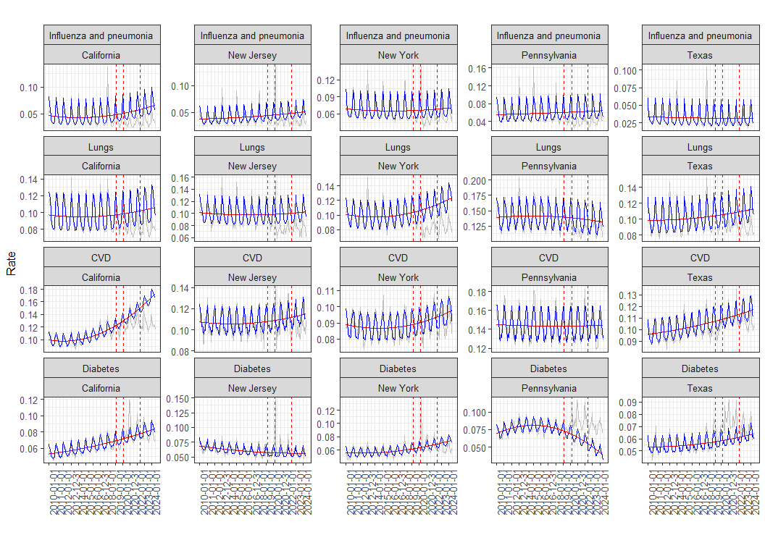
Classical Seasonal Decomposition by Moving Averages
Predicted trend:
trend ~ dt + dt_sqr
Predicted = Predicted Trend + Seasonal [1:12, repeated]
Note: with longer lookback data (Jan 2010 again instead of Jan 2015), the phase is correct again (12 months)
State | Cause | mse | mae | medae
California | Influenza and pneumonia | 9.84E-05 | 9.09E-03 | 9.20E-03
New Jersey | Influenza and pneumonia | 7.44E-05 | 6.60E-03 | 5.51E-03
New York | Influenza and pneumonia | 5.57E-05 | 6.32E-03 | 5.33E-03
Pennsylvania | Influenza and pneumonia | 1.37E-04 | 9.87E-03 | 7.15E-03
Texas | Influenza and pneumonia | 8.68E-06 | 2.06E-03 | 1.66E-03
California | Lungs | 8.26E-05 | 7.23E-03 | 6.52E-03
New Jersey | Lungs | 1.39E-04 | 9.36E-03 | 8.84E-03
New York | Lungs | 7.78E-05 | 6.94E-03 | 5.58E-03
Pennsylvania | Lungs | 6.38E-05 | 6.36E-03 | 4.85E-03
Texas | Lungs | 6.90E-05 | 5.54E-03 | 2.33E-03
California | CVD | 1.10E-04 | 9.52E-03 | 8.69E-03
New Jersey | CVD | 3.14E-05 | 4.20E-03 | 2.76E-03
New York | CVD | 2.40E-05 | 3.86E-03 | 3.21E-03
Pennsylvania | CVD | 5.76E-05 | 5.45E-03 | 3.38E-03
Texas | CVD | 5.80E-05 | 6.68E-03 | 5.51E-03
California | Diabetes | 1.43E-05 | 2.91E-03 | 2.74E-03
New Jersey | Diabetes | 2.62E-05 | 4.62E-03 | 4.46E-03
New York | Diabetes | 2.46E-05 | 4.49E-03 | 4.56E-03
Pennsylvania | Diabetes | 6.64E-05 | 7.27E-03 | 6.13E-03
Texas | Diabetes | 4.85E-05 | 6.45E-03 | 6.06E-03

Slide 10
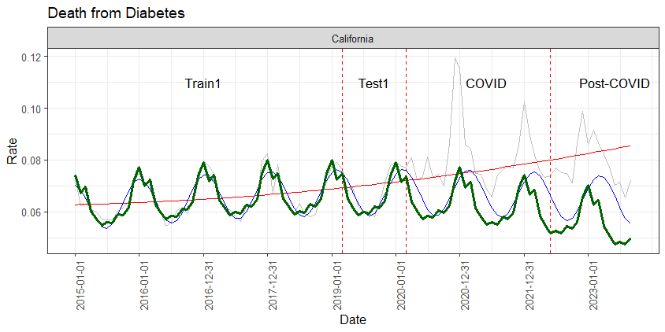
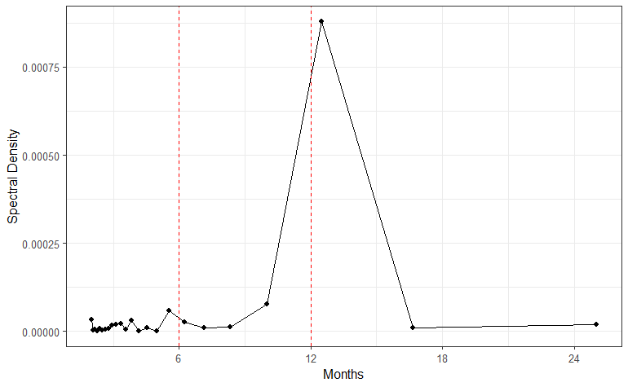
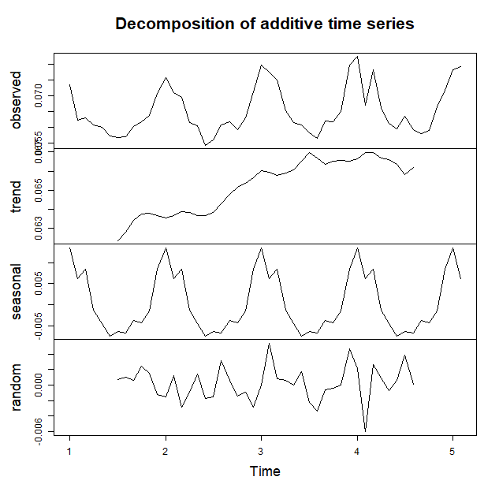
Previous Results for Death from Diabetes in California
State | Set | MAPE (NLS) | MAPE (Seasonal)
California | Train1 | 4.32 | 3.24
California | Test1 | 3.29 | 4.67
California | COVID | 15.48 | 21.89
California | Post-COVID | 18.15 | 29.96

Slide 11
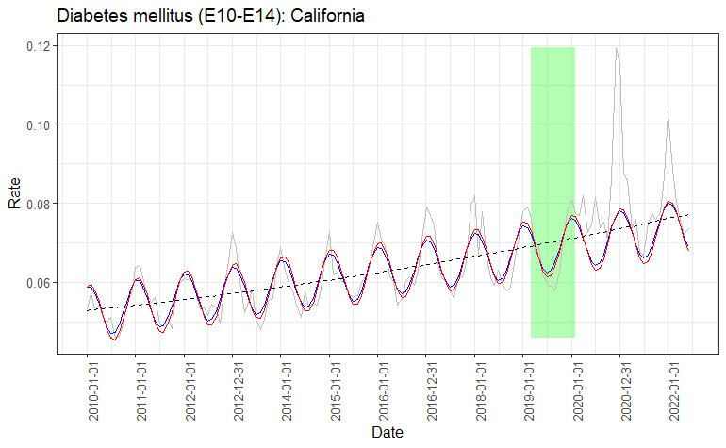
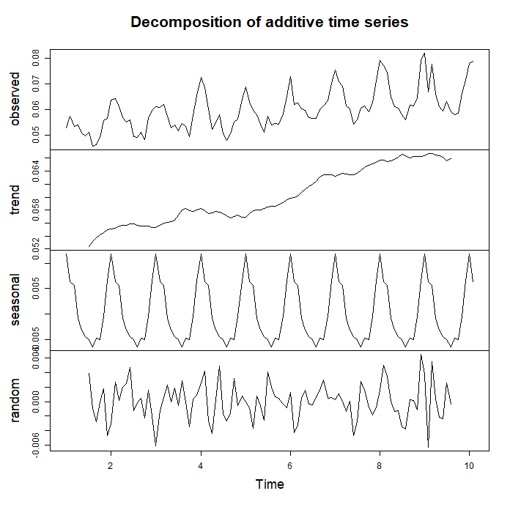
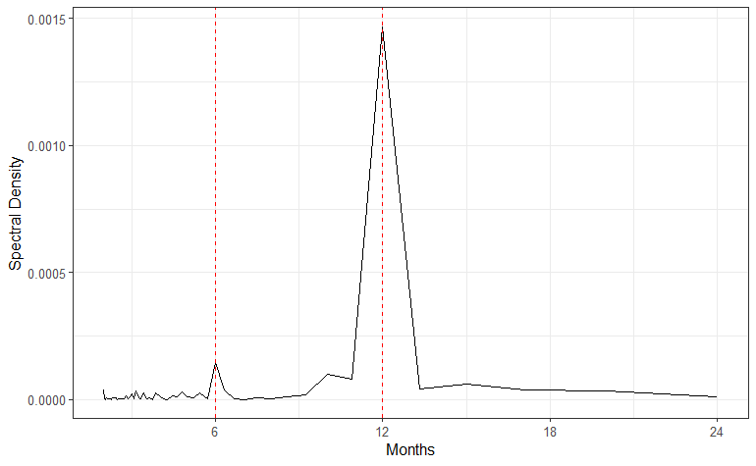
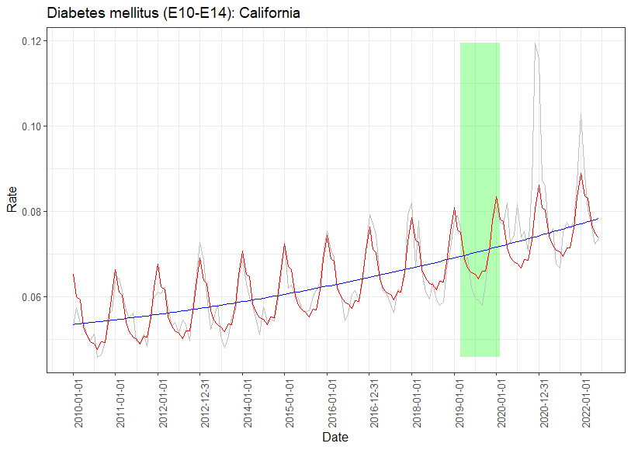
Original Results
Set | MAPE (NLS) | MAPE (Seasonal)
Training | 4.75 | 3.98
Testing | 5.03 | 4.41
COVID-19 | 10.00 | 8.00

Slide 12
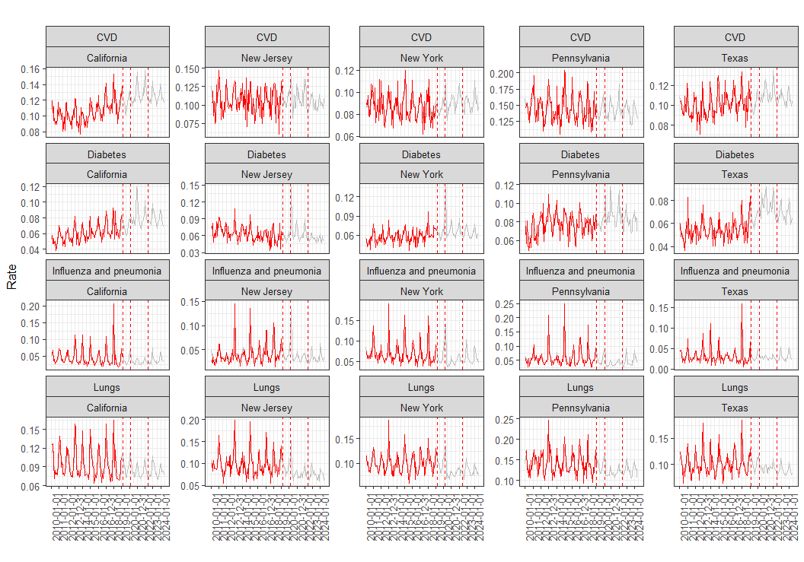
Tensor Auto Regressive Model

Slide 13
Previous Results Part I: 2010-2022 Data with Causes of Death

Slide 14
Only the states that reached at least 10 CVD deaths daily were kept in the analysis

Slide 16
Mixed-effects nonlinear model
Rate ~ b0 + b1*dt + b2*dt^2 + b3*sin(b4 + b5*dt) | State
where b0: y-intersept; b1: linear trend; b2: quadratic term; b3: wave magnitude; b4: wave offset left; b5: wavelength.
Cause of death | b0 | b1 | b2 | b3 | b4 | b5
Alzheimer disease (G30) | 0.4277 | -5.40E-05 | 2.04E-09 | 0.0119 | 15.14 | 0.0171
Cerebrovascular diseases (I60-I69) | 0.4727 | -4.78E-05 | 1.61E-09 | 0.0107 | 14.67 | 0.0172
Chronic lower respiratory diseases (J40-J47) | -0.1350 | 2.89E-05 | -7.55E-10 | 0.0226 | 13.80 | 0.0172
Diabetes mellitus (E10-E14) | 0.0154 | 3.97E-06 | -4.42E-11 | 0.0070 | 13.43 | 0.0172
Diseases of heart (I00-I09,I11,I13,I20-I51) | 1.1233 | -7.92E-05 | 2.72E-09 | 0.0547 | 14.26 | 0.0172
Influenza and pneumonia (J09-J18) | -0.3035 | 4.26E-05 | -1.29E-09 | 0.0170 | 14.89 | 0.0171
Malignant neoplasms (C00-C97) | 0.1835 | 4.27E-05 | -1.34E-09 | 0.0096 | 14.47 | 0.0172
Other_rev | 0.1453 | 3.95E-05 | -2.92E-13 | 0.0501 | 14.64 | 0.0172
Other diseases of respiratory system (J00-J06,J30- J39,J67,J70-J98) | 0.0644 | -7.29E-06 | 3.33E-10 | 0.0043 | 14.42 | 0.0172

Slide 17
Mixed-effects nonlinear model Mean Absolute Percent Error
MAPE = 100*mean(abs(Rate - prd3)/(Rate)))
Cause of Death | Training | Testing | COVID-19
Alzheimer disease (G30) | 8.65 | 14.21 | 28.05
COVID-19 (U07.1) | 6.64 | 7.38 | 14.91
Cerebrovascular diseases (I60-I69) | 5.06 | 5.39 | 5.99
Chronic lower respiratory diseases (J40-J47) | 6.11 | 5.85 | 14.80
Diabetes mellitus (E10-E14) | 3.11 | 2.93 | 6.20
Diseases of heart (I00-I09,I11,I13,I20-I51) | 15.66 | 14.61 | 39.57
Influenza and pneumonia (J09-J18) | 2.16 | 2.12 | 3.01
Malignant neoplasms (C00-C97) | 2.80 | 2.43 | 7.66
Other diseases of respiratory system (J00-J06,J30- J39,J67,J70-J98) | 8.65 | 14.21 | 28.05
Other_rev | 9.39 | 10.91 | Inf

Slide 18
Mixed-effects nonlinear model Excess Death
Deaths_prd := prd3*daysmonth*Population*10^(-5)
Excess Death (% predicted) = 100*sum(Deaths - Deaths_prd)/sum(Deaths_prd)
Cause of Death | Training | Testing | COVID-19
Alzheimer disease (G30) | 8.65 | 14.21 | 28.05
COVID-19 (U07.1) | 6.64 | 7.38 | 14.91
Cerebrovascular diseases (I60-I69) | 5.06 | 5.39 | 5.99
Chronic lower respiratory diseases (J40-J47) | 6.11 | 5.85 | 14.80
Diabetes mellitus (E10-E14) | 3.11 | 2.93 | 6.20
Diseases of heart (I00-I09,I11,I13,I20-I51) | 15.66 | 14.61 | 39.57
Influenza and pneumonia (J09-J18) | 2.16 | 2.12 | 3.01
Malignant neoplasms (C00-C97) | 2.80 | 2.43 | 7.66
Other diseases of respiratory system (J00-J06,J30- J39,J67,J70-J98) | 8.65 | 14.21 | 28.05
Other_rev | 9.39 | 10.91 | Inf

Slide 19
State | Observed Death During Testing Months (2019/03/01 to 2020/02/28, % Predicted)
 | Alzheimer disease (G30) | Cerebrovascular diseases (I60-I69) | Chronic lower respiratory diseases (J40-J47) | Diabetes mellitus (E10-E14) | Diseases of heart (I00-I09,I11,I13,I20-I51) | Influenza and pneumonia (J09-J18) | Malignant neoplasms (C00-C97) | Other_rev | Other diseases of respiratory system (J00-J06,J30- J39,J67,J70-J98)
Alabama | -11.1 | 1.0 | -4.3 | 7.7 | -1.6 | -1.7 | -2.3 | 1.1 | -11.8
Arizona | -9.8 | -4.6 | -10.0 | -2.5 | -0.3 | 11.9 | 0.9 | 0.3 | -7.8
California | -6.3 | -2.0 | -0.7 | -0.8 | -1.1 | -2.0 | 0.2 | 2.1 | -0.1
Florida | -19.3 | -0.4 | -3.6 | -0.2 | -1.2 | 3.2 | 0.3 | 0.2 | 0.0
Georgia | -16.9 | -6.6 | -6.8 | -2.4 | 1.5 | -1.7 | 0.8 | 3.0 | -9.8
Illinois | -11.1 | -0.1 | -1.6 | -4.1 | -1.4 | -3.2 | -0.5 | -1.2 | -12.3
Indiana | -13.2 | 5.2 | 2.1 | -6.3 | -0.6 | -3.6 | 1.0 | -1.0 | -1.1
Maryland | -20.7 | 1.0 | 3.7 | 2.8 | -0.1 | -10.6 | -0.8 | -2.5 | -7.6
Michigan | -9.8 | -0.1 | 2.4 | 5.7 | -2.6 | 2.4 | 0.6 | -0.2 | 2.8
Missouri | 3.3 | -3.8 | -5.5 | 1.5 | -1.2 | -12.2 | -0.7 | -1.9 | 6.6
New Jersey | -14.0 | 0.7 | -3.1 | 7.4 | -2.5 | 0.8 | -0.5 | -0.2 | 5.0
New York | -7.4 | -3.5 | 2.6 | 5.5 | -1.9 | 0.6 | 0.0 | 1.3 | 11.0
North Carolina | -8.5 | -2.9 | -3.8 | -4.2 | -0.5 | -7.5 | 0.0 | -0.1 | -8.6
Ohio | -8.8 | -0.5 | -0.9 | 1.4 | -0.1 | -10.0 | -0.9 | -2.0 | -9.1
Pennsylvania | -9.6 | -0.4 | -1.9 | -2.1 | -2.7 | -6.2 | 0.5 | -1.7 | -3.3
South Carolina | -22.4 | -8.6 | -7.1 | 2.4 | -2.6 | -6.7 | -0.8 | 0.5 | 13.4
Tennessee | -14.9 | -2.7 | -3.2 | 10.4 | 1.5 | -8.2 | -0.5 | 2.1 | 12.9
Texas | -11.6 | -7.4 | 0.3 | 11.3 | -2.2 | 5.6 | 2.2 | 2.2 | -10.7
Virginia | -5.8 | 1.5 | 9.1 | 4.0 | 0.6 | -9.3 | 0.5 | 0.7 | 1.5
Washington | -9.3 | -4.5 | -2.8 | -1.3 | 0.4 | 2.0 | 0.0 | 1.9 | 0.2

Slide 20
State | Observed Death During COVID-19 (2020/03/01 to 2022/06/01, % Predicted)
 | Alzheimer disease (G30) | Cerebrovascular diseases (I60-I69) | Chronic lower respiratory diseases (J40-J47) | Diabetes mellitus (E10-E14) | Diseases of heart (I00-I09,I11,I13,I20-I51) | Influenza and pneumonia (J09-J18) | Malignant neoplasms (C00-C97) | Other_rev | Other diseases of respiratory system (J00-J06,J30- J39,J67,J70-J98)
Alabama | -16.4 | -4.1 | -15.1 | 44.9 | 4.6 | -10.3 | -2.4 | 7.9 | -10.8
Arizona | -22.3 | -1.8 | -15.9 | 5.3 | 7.8 | 11.9 | 1.6 | 12.6 | -8.5
California | -11.1 | 0.2 | -7.0 | 12.7 | 2.9 | -11.6 | 2.5 | 14.3 | -12.5
Florida | -25.0 | -0.2 | -13.0 | 21.2 | 1.4 | 12.6 | 2.0 | 6.8 | -12.4
Georgia | -24.4 | -4.0 | -11.8 | 14.1 | 7.1 | 5.5 | 1.3 | 14.4 | -6.5
Illinois | -13.9 | 1.2 | -10.2 | 13.7 | 0.0 | -11.5 | -1.5 | -1.0 | -19.5
Indiana | -26.0 | 3.0 | -5.8 | 11.3 | 0.5 | -16.3 | 1.9 | 2.5 | -6.7
Maryland | -19.7 | -1.2 | -6.8 | 18.5 | 1.7 | -30.2 | -1.4 | -5.0 | -36.2
Michigan | -19.6 | 2.2 | -10.6 | 23.1 | -0.9 | -8.9 | 1.0 | 3.2 | -9.6
Missouri | -11.5 | 3.1 | -8.4 | 13.9 | 3.2 | -16.4 | 3.8 | 3.9 | -3.6
New Jersey | -24.4 | 1.2 | -11.3 | 32.4 | -2.5 | 11.8 | -1.0 | -4.9 | 13.9
New York | -22.7 | -0.8 | -9.9 | 15.9 | 0.4 | -0.4 | -0.2 | 5.2 | 7.1
North Carolina | -21.6 | -1.4 | -16.0 | 10.3 | 3.5 | -22.7 | 0.0 | 5.8 | -13.2
Ohio | -13.3 | 3.3 | -10.3 | 17.5 | 1.3 | -17.0 | -1.2 | -2.0 | -10.1
Pennsylvania | -12.0 | 0.1 | -10.6 | 14.1 | -3.4 | -21.7 | 1.2 | -1.1 | -12.4
South Carolina | -27.4 | -4.9 | -14.4 | 4.5 | 2.8 | -33.1 | -2.8 | 5.1 | 5.7
Tennessee | -24.2 | 8.2 | -10.8 | 33.7 | 9.6 | -11.5 | 2.0 | 14.0 | 13.3
Texas | -16.6 | -2.6 | -6.6 | 28.3 | 2.8 | 10.7 | 4.2 | 14.1 | -15.0
Virginia | -17.6 | 3.0 | -5.6 | 9.6 | 5.0 | -13.6 | 1.9 | 7.9 | -8.5
Washington | -14.3 | -5.7 | -7.3 | 15.9 | 4.8 | -46.2 | 3.2 | 13.5 | -9.7

Slide 21
PCA on observed daily death (as % of predicted)
Influenza death were higher than predicted in TX, FL, AZ, GE and NJ
Diabetes deaths exceeded the predicted the most in NJ, NY and TN

Slide 22
Population dynamics (% Jan 2010) in the US 51 states between Jan 2010 and June 2022
Error bars indicate 95% CI calculated on the Testing data
Green dots are the observed deaths as % of predicated, by State
The model underestimated deaths from Alzheimer even during the Testing years
During COVID-19 years, the predicted death caused by Alzheimer, Chronic Lower Respiratory and Influenza were much lower that expected from the Testing set, while Diabetes death was much higher than expected

Slide 23
Part II: 2015-2023 Data without Causes of Death

Slide 24
Data processing and subsetting
DeathDaily = Death/daymonth (i.e., average daily death = average monthly death/number of days in that month)
Data starts at 2015-01-01. Removed records: Date >= 2023-05-01
Divided data into training (before 2019/03/01), testing (2019/03/01 to 2020/02/28 or 29) and Covid-19 (2020/03/01 to 2022/06/01)
Calculated Rate (no more zeros) = 10^5*(Deaths/(daymonth*Population)
NOTE: if there were zeros then Rate = 10^5*(Deaths + 1)/(daymonth*(Population + 1))

Slide 25
Population dynamics in the US states and territories
by State between Jan 2015 and May 2023

Slide 26
Daily All-Cause Death in the US states and territories
by State between Jan 2015 and May 2023

Slide 27
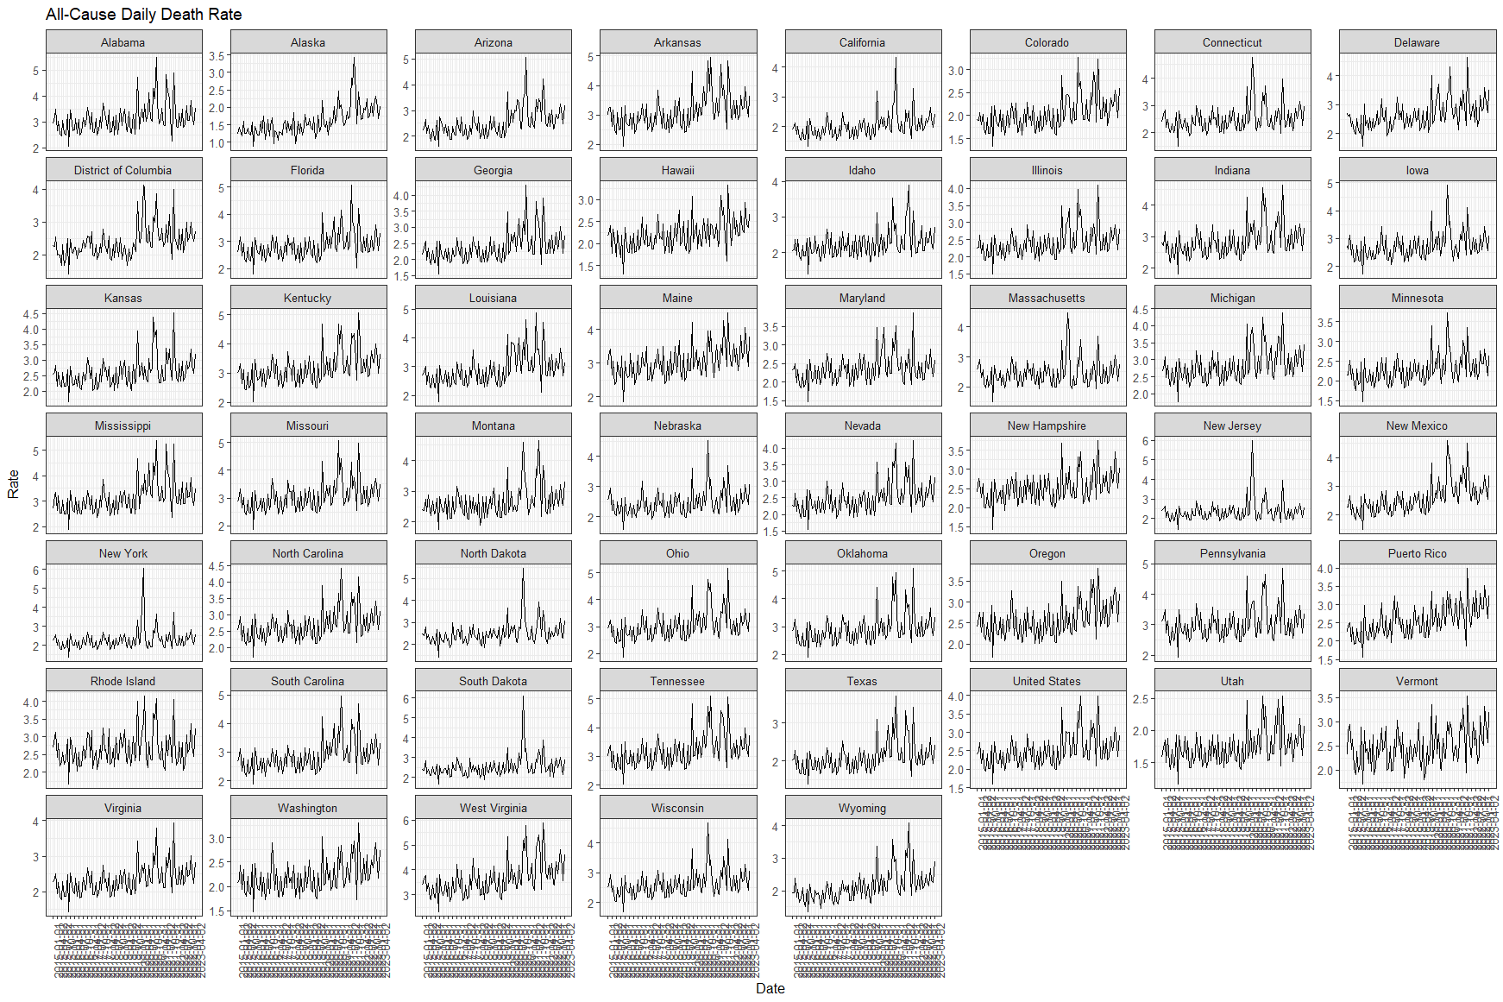
Daily All-Cause Death Rate in the US states and territories
by State between Jan 2015 and May 2023, per 10^ of Population

Slide 28
Daily COVID-19 Death in the US states and territories
by State between Jan 2015 and May 2023

Slide 29
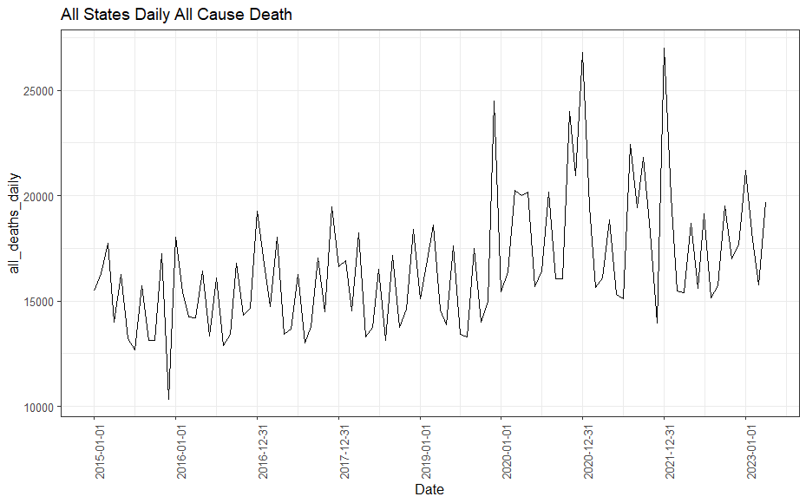
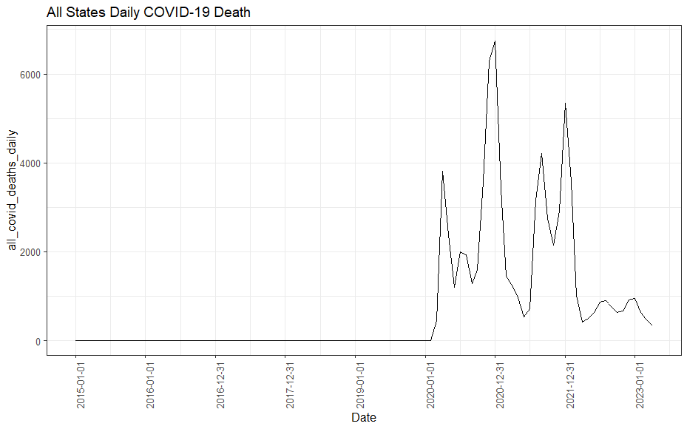
Daily COVID-19 Death in the US states and territories
All States Combined between Jan 2015 and May 2023

Slide 30
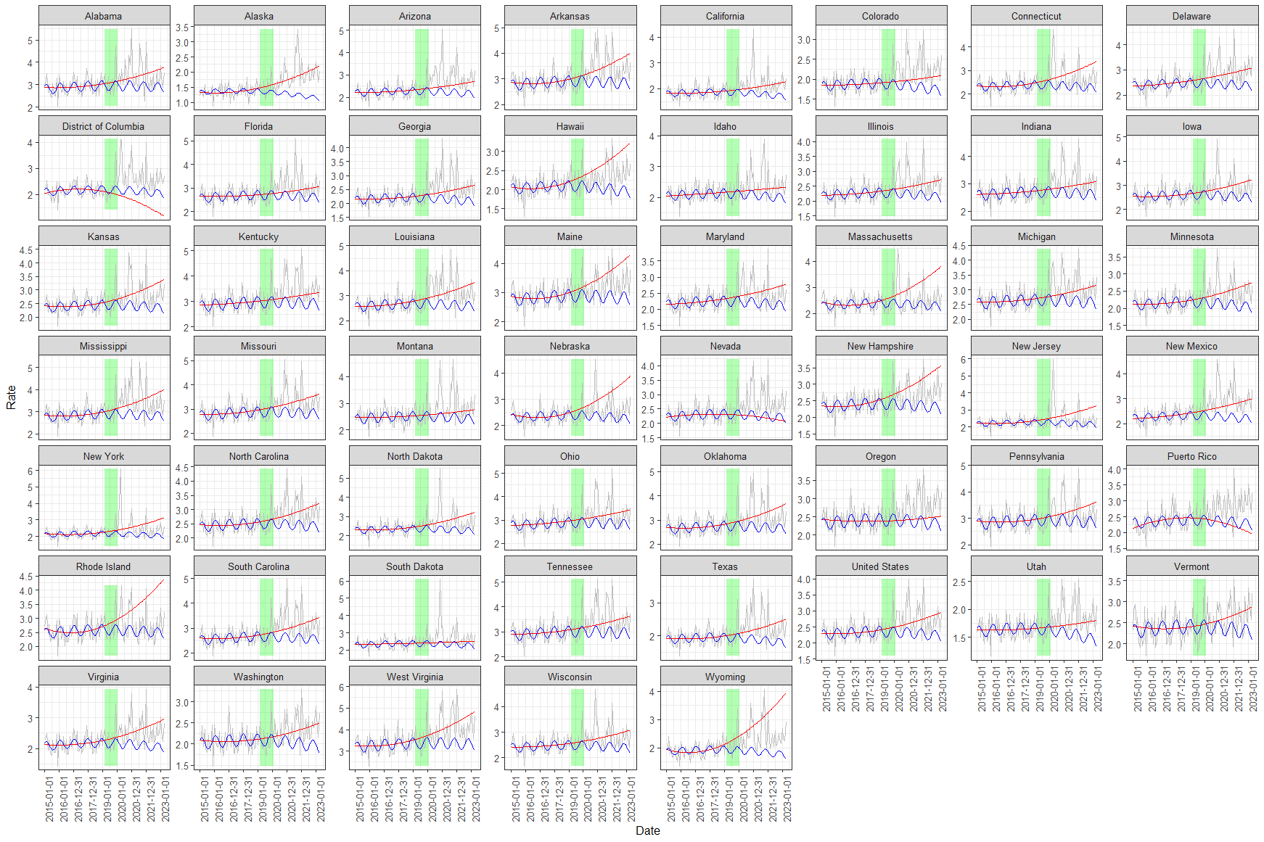
Daily All-Cause Death Rate in the US states and territories
by State between Jan 2015 and May 2023, per 10^ of Population
Quadratic and Sinusoidal Fits

